Slide 1
SUPPLY AND DEMAND THEORY (Part 2)

Slide 2
SUPPLY

Slide 3
SUPPLY
SUPPLY:
The willingness and ability of sellers to produce and offer to sell different quantities of a good at different prices during a specific time period.
LAW OF SUPPLY:
As the price of a good rises, the quantity supplied of the good rises, and as the price of a good falls, the quantity supplied of a good falls, ceteris paribus.
So, the quantity supplied and price of a good are DIRECTLY related ➔ Slope?

Slide 4
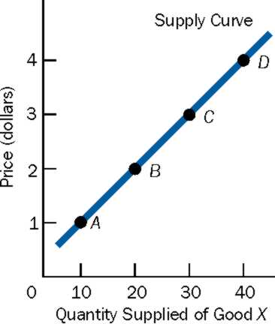
Supply Curve
The upward-sloping supply curve is the graphical representation of the law of supply.
Upward sloping, as per law of supply, ceteris paribus.
Price (y-axis) represents price per unit of a good.
Quantity Supplied (x-axis) at each price for a specific period of time (a week, month,etc)

Slide 5
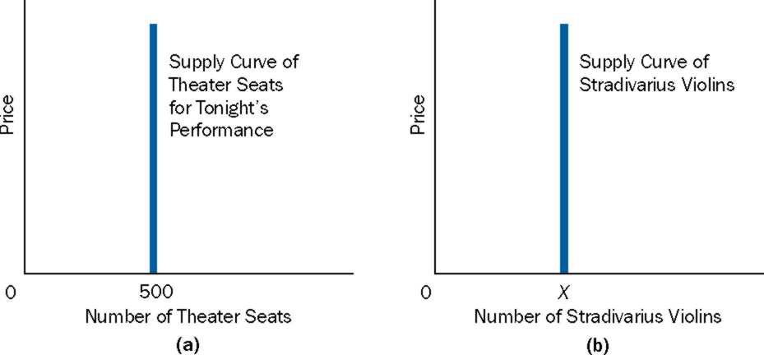
Supply (Cont)
The law of supply does holds for the production of most goods.
However, it does not hold in two cases.
It does not hold when there is no time to produce more units of a good.
The law of supply does not hold for goods that cannot be produced over a period of time.

Slide 6
Supply (Cont)
Why Most Supply Curves are Upward sloping?
➔ Increasing opportunity costs ➔ costs rise as more units of goods are produced.
Individual Supply Curve: Represents price-quantity combinations of a SINGLE seller
Market Supply Curve: Represents price-quantity combinations of a ALL sellers
Market supply curve is derived by “adding” individual supply curves

Slide 7
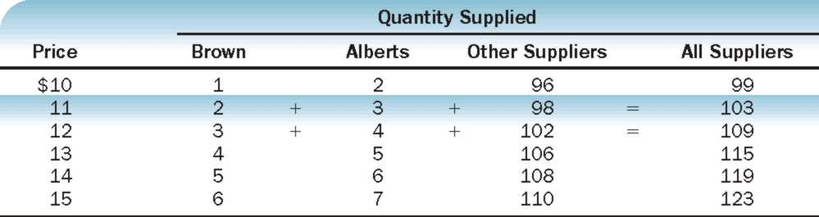
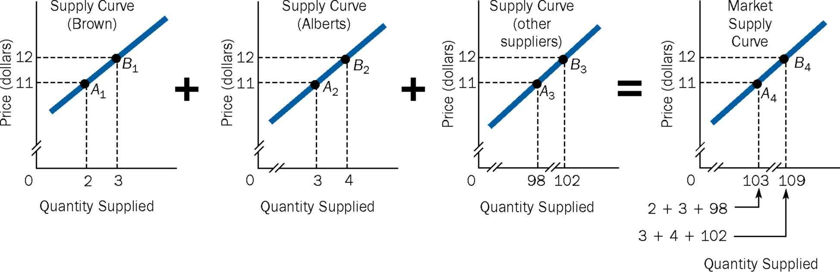
Deriving a Market Supply Schedule and a Market Supply Curve
(a)
(b)

Slide 8
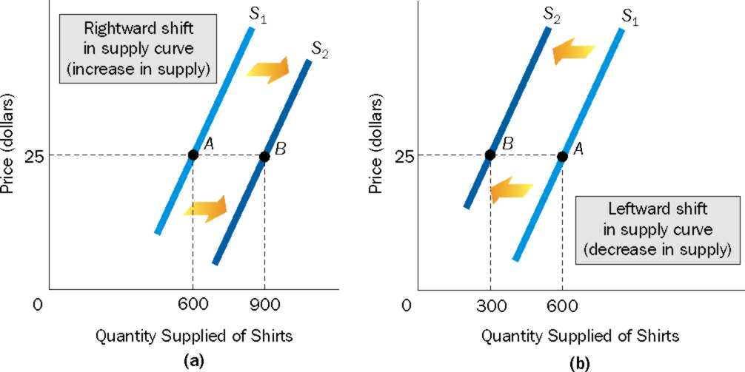
Changes in Supply Means Shifts in Supply Curves
Suppliers are willing and able to produce and offer to sell more (less) of the good at all prices ➔ demand shifts right (left).

Slide 9
What Factors Cause the Supply Curve to Shift?
The following causes the supply curve to SHIFT:
Prices of Relevant Resources
Technology
Prices of other goods
Number of Sellers
Expectations of Future Prices
Taxes and subsidies
Government Restrictions

Slide 10
What Factors Cause the Supply Curve to Shift?
PRICES OF RELEVANT RESOURCES: Resources are needed to produce goods. Example?
TECHNOLOGY: Defined as the body of skills and knowledge concerning the use of resources in production. Also, advancement in technology refers to the ability to produce more output with a fixed amount of resources, thus reducing per unit costs.
PRICES OF OTHER GOODS: Change in price of one good leads to a change in the supply of another good.

Slide 11
What Factors Cause the Supply Curve to Shift?
NUMBER OF SELLERS: If a good is profitable ➔ number of seller increases ➔ Supply increases ➔ shift to right.
EXPECTATIONS ON FUTURE PRICES: if future prices ➔ producers may hold back the products and sell at a later date, when prices may be higher ➔ Current Supply ➔ Supply shifts left.

Slide 12
What Factors Cause the Supply Curve to Shift?
TAXES AND SUBSIDIES:
Taxes: If per-unit tax that needs to paid to government increases ➔ Per unit cost increases ➔cost of production rises and prices unchanged ➔ profit from each unit decreases ➔ decreased incentive to produce more ➔ produce and offer to sell less at each and every prices ➔ supply decreases ➔ shifts left.
Subsidy: A monetary payment by the government to a producer of a good or service. If per unit subsidy ➔ Per unit cost decreases ➔ cost of production falls and prices unchanged ➔ profit from each unit increases ➔ increased incentive to produce more ➔ produce and offer to sell more at each and every prices ➔ supply increases ➔ shifts right.

Slide 13
What Factors Cause the Supply Curve to Shift?
GOVERNMENT RESTRICTIONS:
Government may put certain restrictions. Two examples:
Import Quota (case of Malaysian Automobile Industry, Proton)
Licensure: With licensure, individuals must meet certain requirements before they can legally carry out a task.

Slide 14
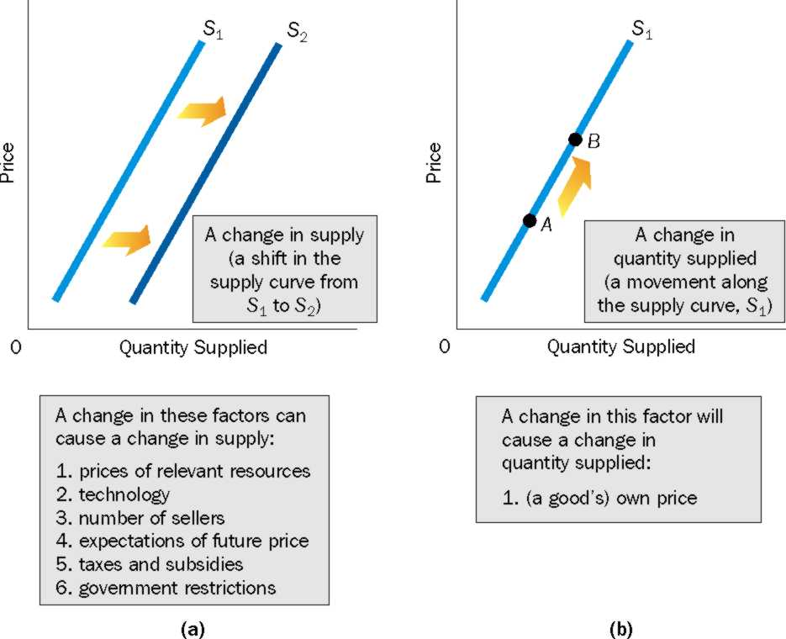
A Change in Supply versus a Change in Quantity Supplied

Slide 15
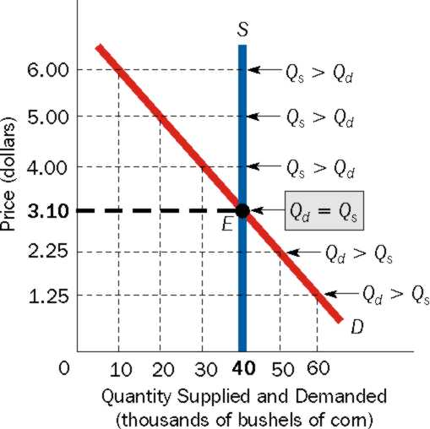
The Market: Putting Demand and Supply Together
Assume we at an auction with a fixed supply of bushels of corn.

Slide 16
The Language of Supply and Demand: A few Important Terms.
Surplus: A condition in which quantity supplied is greater than quantity demanded. Surpluses occur only at prices above equilibrium price.
Shortage: A condition in which quantity supplied is less than quantity demanded. Shortages occur only at prices below equilibrium price.
Equilibrium Price (Market-Clearing Price): The price at which quantity demanded of the good equals quantity supplied.

Slide 17
The Language of Supply and Demand: A few Important Terms.
Equilibrium Quantity: The quantity that corresponds to equilibrium price. The quantity at which the amount of the good that buyers are willing and able to buy equals to the amount that sellers are able and willing to sell, and both equal to the amount actually bought and sold.
Equilibrium: Equilibrium means “at rest”. Equilibrium in a market is the price quantity combination from which there is no tendency for buyers or sellers to move away. Graphically, equilibrium is the intersection point of the supply and demand curves.

Slide 18
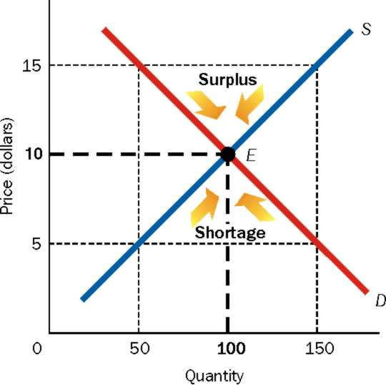
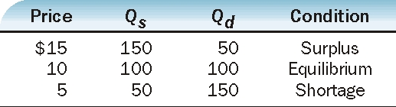
Moving to Equilibrium
Why does the price fall when there is a surplus?
Why does the price rise when there is a shortage?
Mutually beneficial exchange drives the market towards equilibrium.

Slide 19
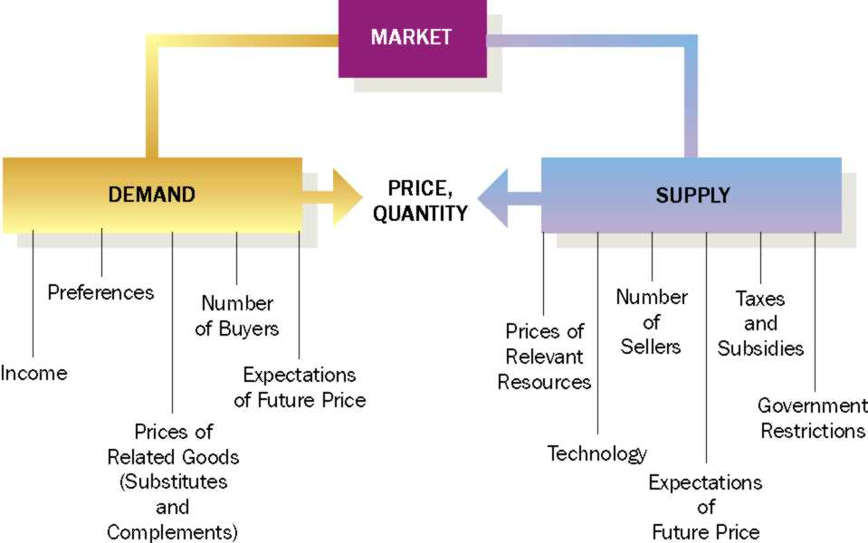
Summarizing…

Slide 20
Speed of Moving To Equilibrium
Think of the stock market. How quickly does the market achieve equilibrium?
Think of the housing market. How quickly does the market achieve equilibrium?
Conclusion: Not all markets equilibrate at the same speed.

